Slide 1
Practical Malware Analysis
Chapter 5: IDA Pro
2026/01/14
Woojin Jeon

Slide 2
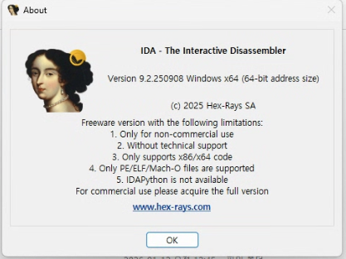
Interactive Disassembler Professional (IDA Pro)
Powerful disassembler and reverse engineering platform developed by Hex-Rays
Malware analysis, vulnerability research, reverse engineering, firmware analysis
Interactive disassembler
Can add comments, label data, name functions, and save your analysis work
IDA Pro, IDA Home, IDA Free

Slide 3
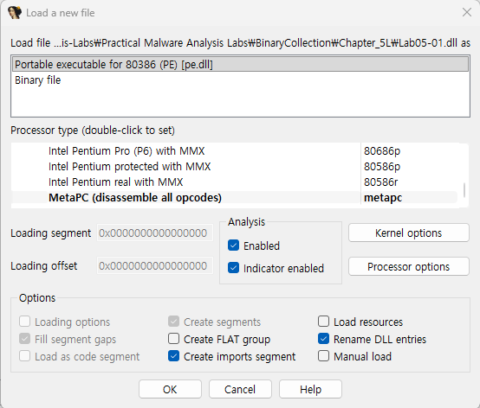
Loading an Executable
File format: PE format
Choose if you want disassemble the file as a raw binary
Recommended processor type
Notes:
Processor type = 이 파일의 기계어를 어떤 CPU 아키텍처의 명령어로 해석할 것인가

Slide 4
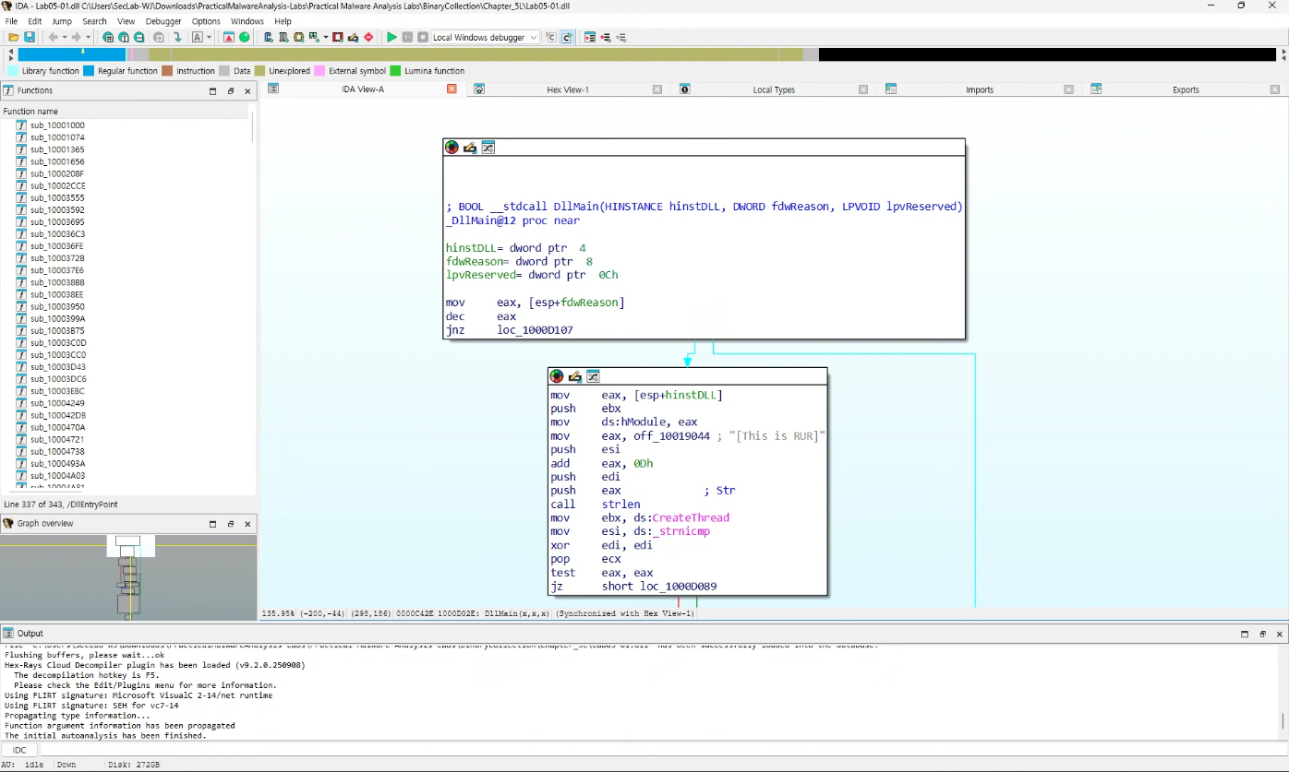
IDA Pro Interface
Switch mode with space bar

Slide 5
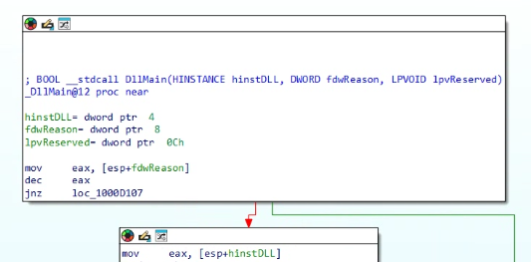
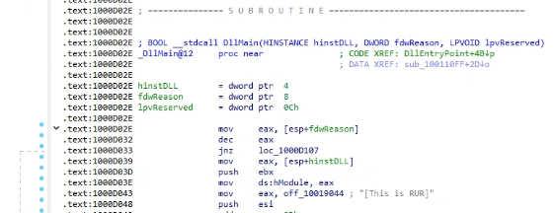
IDA Pro Interface
Switch mode with space bar
Text Mode
Graph Mode

Slide 6
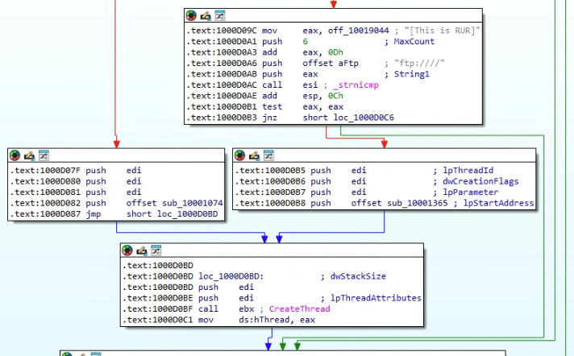
IDA Pro Interface
Graph Mode
Arrow
Red: Conditional jump – False branch
Green: Conditional jump – True branch
Blue: Unconditional jump
Up: Loop

Slide 7
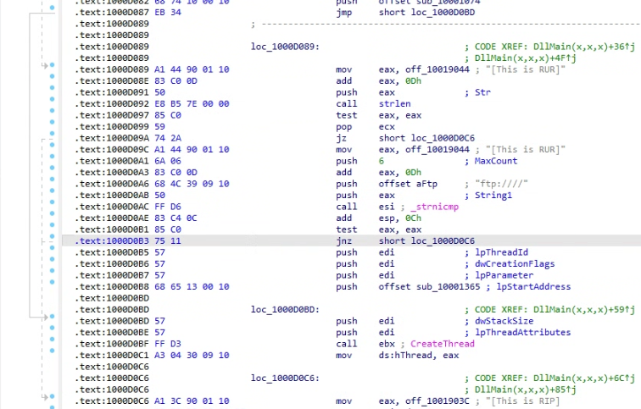
IDA Pro Interface
Text Mode
Section
Address
Comment generated by IDA Pro
Solid: Unconditional jump
Dashed: Conditional jump
Up: Loop

Slide 8
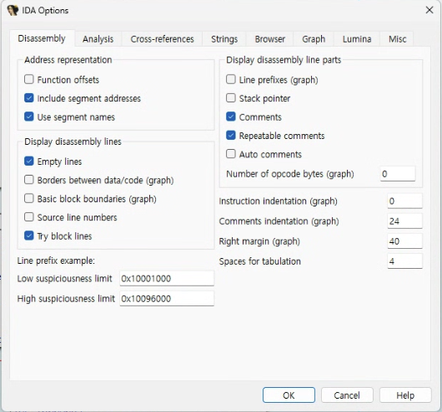
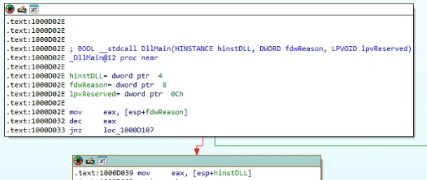
IDA Pro Interface
Options → General

Slide 9
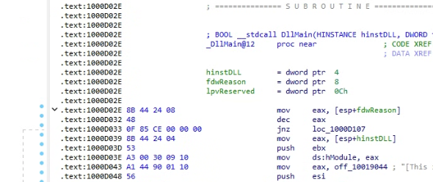
IDA Pro Interface
Options → General
6

Slide 10
Useful Windows for Analysis
Disassembly window

Slide 11
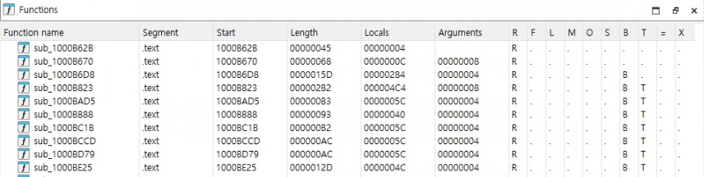
Useful Windows for Analysis
Functions, Names, Strings, Imports, Exports, Structures
All functions, and their segment, length, and associated flags

Slide 12
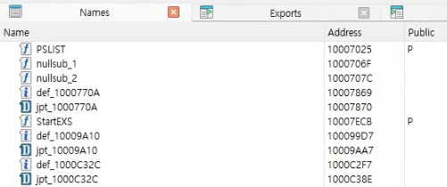
Useful Windows for Analysis
Functions, Names, Strings, Imports, Exports, Structures
Every address with a name
Functions, named code, named data, and strings

Slide 13
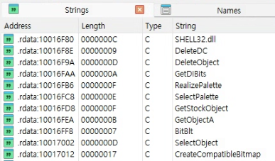
Useful Windows for Analysis
Functions, Names, Strings, Imports, Exports, Structures

Slide 14
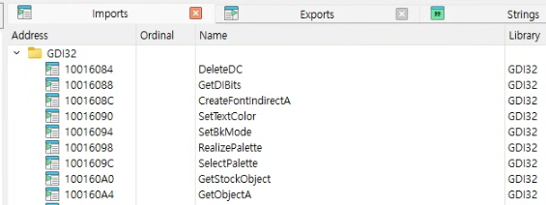
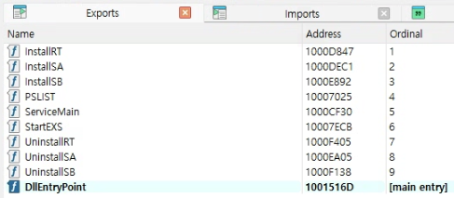
Useful Windows for Analysis
Functions, Names, Strings, Imports, Exports, Structures

Slide 15
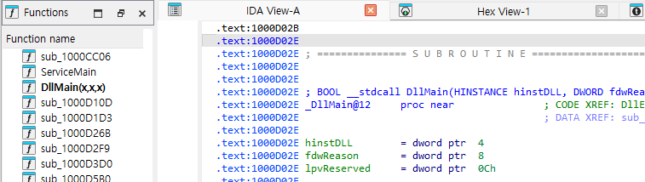
Lab
Q1: What is the address of DllMain?

Slide 16
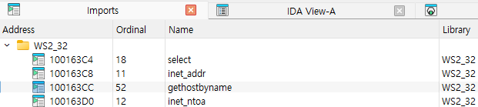

Lab
Q2: Use the Imports window to browse to gethostbyname. Where is the import located?

Slide 17
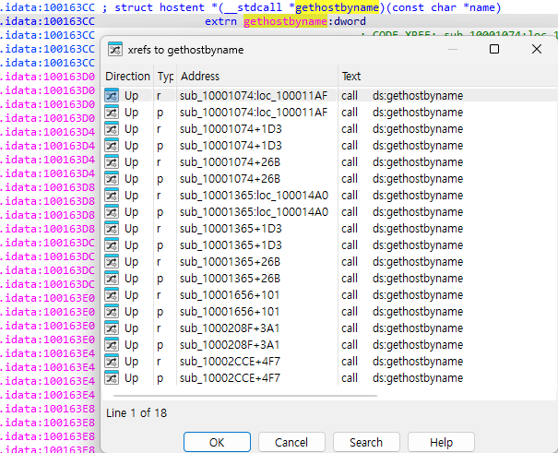
Lab
Q3: How many functions call gethostbyname?
9 times by 5 different functions
Some versions of IDA Pro double-count cross-references (p: reference because it is being called, r: read reference)

Slide 18
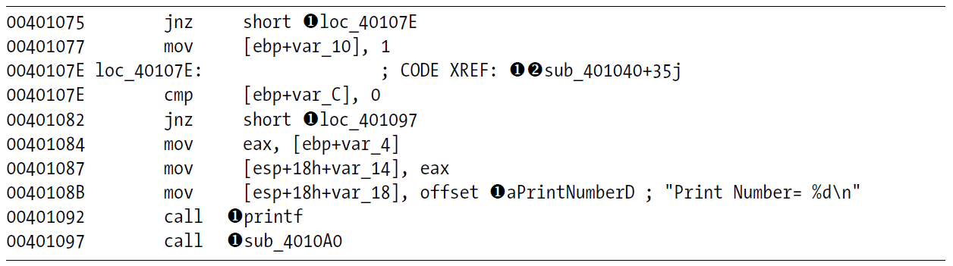
Navigating IDA Pro
Links
Double-click the links in the disassembly window to display that location
Sub links: the start of function
Loc links: jump destinations
Offset link: an offset in memory

Slide 19

Navigating IDA Pro
Exploring Your History

Slide 20
Navigating IDA Pro
Navigation Band
Library function
Regular function
User-written code
Should perform malware analysis in this region
Data
External symbol

Slide 21
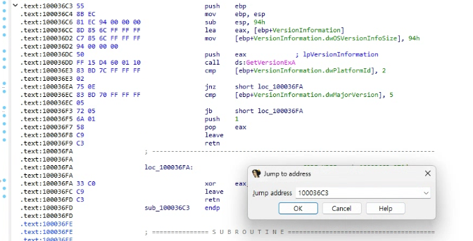
Navigating IDA Pro
Jump to Location
Press G and type address or named location

Slide 22
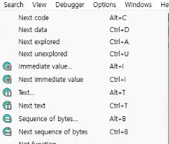
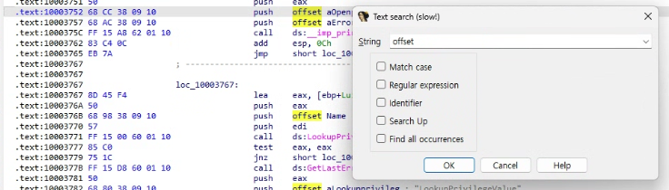
Navigating IDA Pro
Searching
Search → Next Code
Move to the next location containing an instruction
In IDA Free, cannot specify target code
Search → Text
Search the entire disassembly window for a specific string
Search → Sequence of Bytes
Perform a binary search in the hex view window

Slide 23
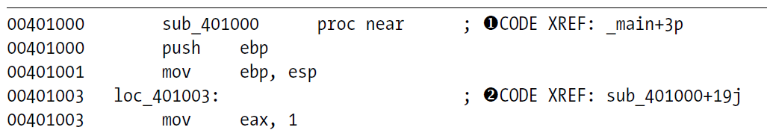
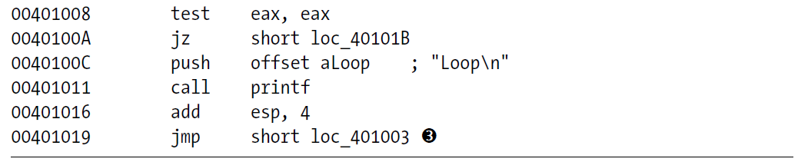
Cross-References
Where a function is called or where a string is used
Code Cross-References
❶: The function sub_401000 is called at offset 0x3 into the main function
❷: which jump (❸) takes us to this location

Slide 24
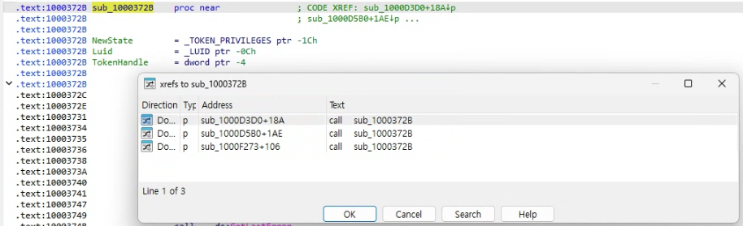
Cross-References
Where a function is called or where a string is used
Code Cross-References
Show only a couple of cross-references for any given function
To view all the cross-references for a function, click the function name and press X

Slide 25
Cross-References
Where a function is called or where a string is used
Code Cross-References
Show only a couple of cross-references for any given function
To view all the cross-references for a function, click the function name and press X

Slide 26
Cross-References
Where a function is called or where a string is used
Data Cross-References
❶: This data is used in the function located at 0x401020

Slide 27
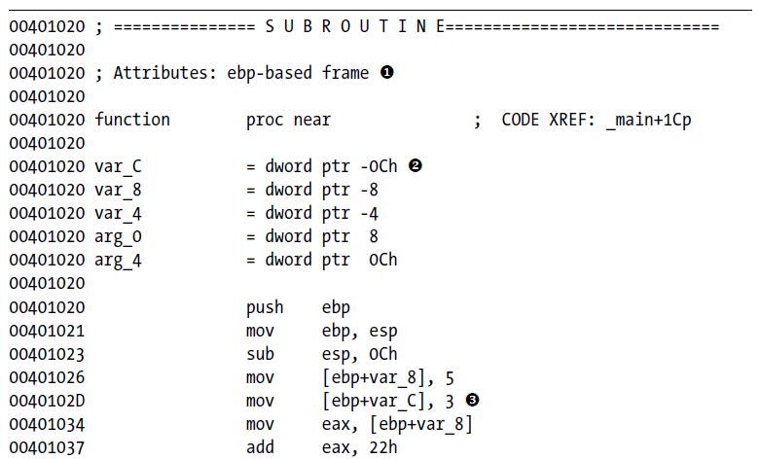

Analyzing Functions
IDA analyzes the stack frame of a function and converts local variables and function arguments into a ‘meaningful form’
❶: This function manages the stack frame (local variable/parameters) using the EBP as a base
❷: var_C corresponds to the value -0xCh
❸: -0xC is substituted with var_C
bp-based frame

Slide 28
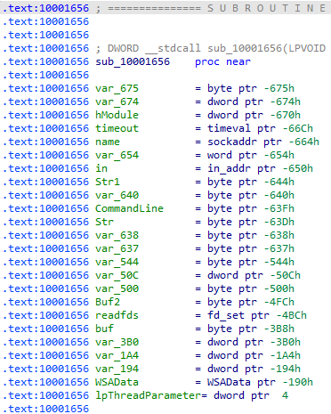
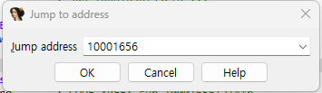
Lab
Q5:How many local variables has IDA Pro recognized for the subroutine at 0x10001656?
Q6. How many parameters has IDA Pro recognized for the subroutine at 0x10001656?
23
a negative offset relative to EBP
1
a positive offset relative to EBP

Slide 29
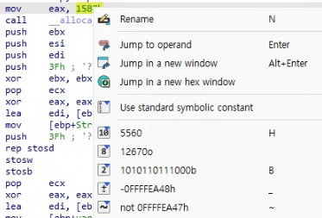
Enhancing Disassembly
IDA Pro allows you to modify its disassembly to suit your goals
“IDA Pro has no undo feature, so be careful when you make changes”
Renaming Auto-generated Names
Comments
Press colon (:) to add a single comment
Press semicolon (;) to echo this comment to all XREFs
Formatting Operands

Slide 30
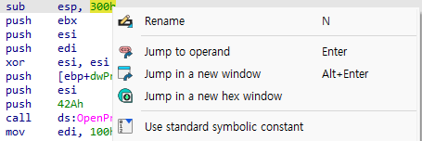
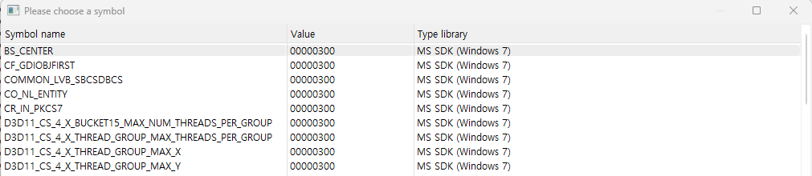
Enhancing Disassembly
Named Constants
Malware authors often use named constants such as GENERIC_READ in their source code
Once compiled, it is no longer possible to determine whether the source used a symbolic constant or a literal
IDA Pro provides a large catalog of named constants for the Windows API and the C standard library
“Number” “Meaning”
To determine which value to choose from the extensive list, we need to go to the MSDN page for the Windows API call

Slide 31
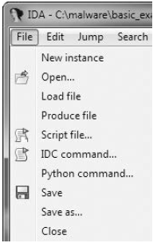
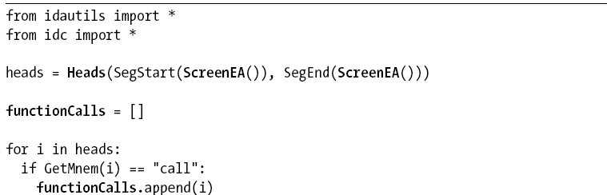
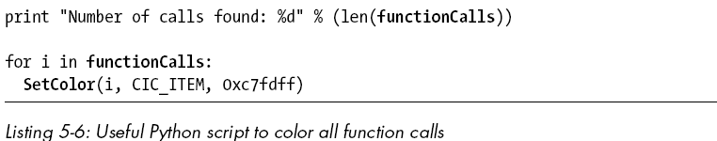
Extending IDA with Plug-ins
Can extend the functionality of IDA Pro via its scripting facilities
IDC Scripts & IDAPython
Manipulate the internals of IDA with code
Automate repetitive tasks
Commercial Plug-ins
Cannot use in IDA Free

